Slide 1


SAP CLOUD APPLICATION PROGRAMMING AND XSA TRAINING IN BTP
Anubhav Oberoy
Day – 7

Slide 2

Agenda – Day 7
Create First Procedure
Expose Procedure as a Service
What is Data flow Logic?
Deep dive inside procedure
Simple procedure with database SELECT
Parameterized procedure
Using Implicit table variables in procedure
Create SQL Script Library
Consume library
Create SQL Script functions
Difference between procedure and functions
Calling functions in procedure
Debugging SQL Script code
Working with Entity Operations
Introduction to Generic Handlers
Custom Handlers
Introduction to CDS Query Language (CQL)
Debugging in NodeJS
What is SAP UI5?
Responsive web design
Client Server Architecture
Structure of UI5 Project
Understanding the MVC Architecture

Slide 3
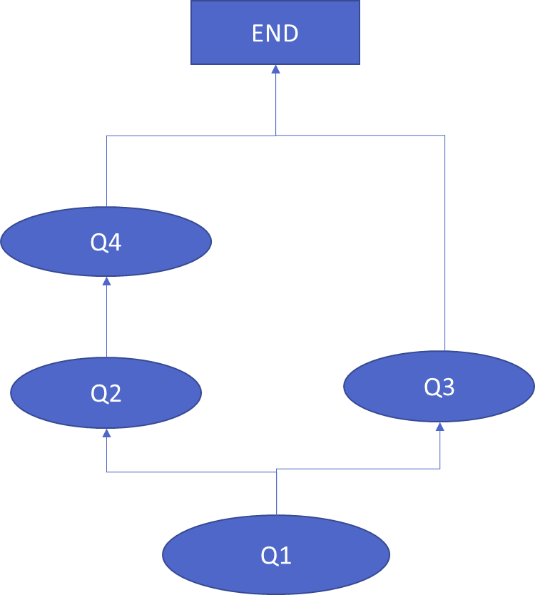
What is Data Flow Logic?
--Q1 (implicit table which gets created in HANA on fly)
Lt_prod = SELECT prod_id FROM products WHERE category = ‘Mice’;
--Q2
Lt_sales = SELECT customer, gross_amount FROM sls WHERE pid IN
( SELECT prod_id FROM :lt_prod );
--Q3
Lt_purchse = SELECT customer, gross_amount FROM purc WHERE pid IN
( SELECT prod_id FROM :lt_prod );
--Q4
Lt_total = SELECT customer, SUM(gross) FROM :lt_sales;
When HANA comes out of parallel mode
Whenever an DML/DDL statement is executed
Whenever an imperative logic is executed IF, LOOP
Whenever an explicit variable is created DECLARE
When a query result is not assigned to any implicit table
Rules
Split the code into multiple containers to keep each container work most time in parallel mode
Keep our imperative logic at end if possible

Slide 4
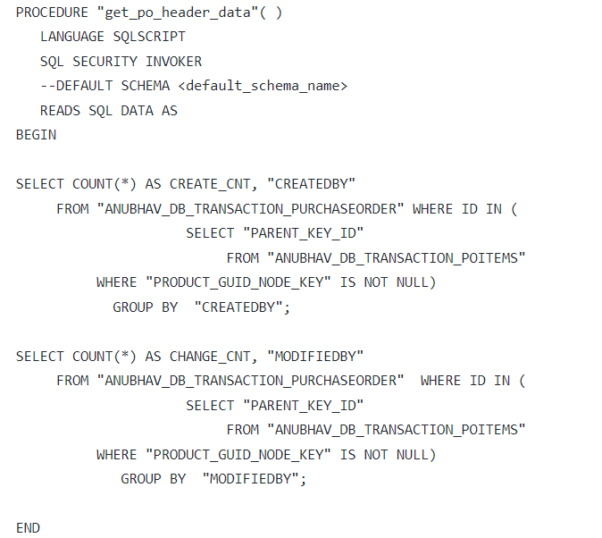
Create First procedure
A procedure is a reusable container which is compiled and stored inside HANA. They can be reused again and again by other procedures and services.
Simple Procedure to Read PO Data

Slide 5
More Exercise on Procedure
We can create procedure with IN, OUT and INOUT parameters to exchange data.
Parameterized Procedure
We can also retrieve the table data from procedure.
Table Data as Output from procedure

Slide 6
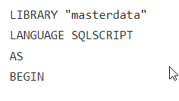
SQL Script Library
A SQL Script library is a collection of reusable procedure and functions, it is mainly used to group containers pertaining to particular area.
Example for SQL Script Library
Syntax and Steps
Create an hdblibrary artefact in SAP Business application studio
Define library using below syntax
Define functions/procedures in the library
Call library functions using libraryname:function_name

Slide 7
SQL Script UDF – User Defined Functions
Functions, or User Defined Functions (UDF), as they are more formally known, allow developers to capture a reusable block of SQLScript code that provides a result after working through some data processing logic. Often, functions allow input parameters to pass key information to the processing logic so that the function can be reused in different scenarios.
Functions are relevant to SAP HANA Cloud modeling because they offer a way to extend the standard capabilities provided with graphical calculation views to reach more complex data processing possibilities. Functions are written in SQLScript language using source files. After a successful deployment, a runtime object is generated from the source file. When executed, functions always run in the in-memory SAP HANA Cloud database, and so performance is optimized.
SAP HANA Cloud supports scalar and table functions. Table and scalar functions are created as source files in a project folder. The source file has the extension .hdbfunction The same extension is used for table and scalar functions.
Functions, both scalar and table, are always read-only. It is not possible to alter the database by using data definition statements such as create table, or data manipulation statements such as update.
Functions can call other functions which encourages a modular approach to ensure high reuse.
Example of SQL Script functions

Slide 8
Procedure v/s Functions
Procedures Functions
Can have multiple OUT parameters
We can have INOUT parameters
Called via call statement
Can be consumed in another procedure and function
Heavy weight
Functions always return ONE RETURN parameter
Do not support INOUT parameter
Always called using Queries
Can be consumed in another procedure and function
Light weight
There are 2 sub-types
SUM, MIN, COUNT, MAX..
Now since we are creating custom functions, we call them user defined functions - UDF
http://sap.optimieren.de/hana/hana/html/_gsql_functions.html

Slide 9
Debugging SQL Script code

Slide 10
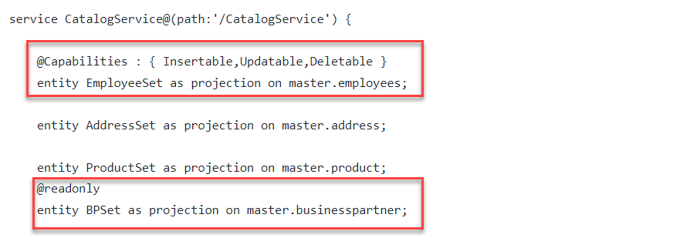
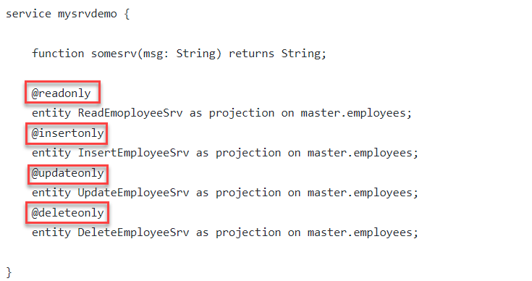
Working with Entity Operations
The CAPM Framework generates most of the code for CURDQ operations on the entity out-of-box. Which means as a developer we have very little effort to build complete applications.
But due to security reasons, we want to disable the operations on an Entity at times. This can be controlled using the annotations in the CDS definition of the service.
@readonly – this annotation disable all the CUD operations on the entity.
@Capabilities – This annotation allows developers to flexibly control the operations on the entity.

Slide 11
Generic Handlers
The CAPM Framework generates most of the code for CURDQ operations on the entity, it also does these operations in synchronous manner. At time, we want to
Take full control on CURDQ
I want to add my custom validations before data is updated
We want to change data with enrichment
Read data we want to add extra information
When? - on, before, after
Who? - ENTITY - Employee
Operation? – CREATE, UPDATE
What? – Validate if input Sal < 1mn
User/Developer
Service
CAPM Framework
DB
before
on
after

Slide 12
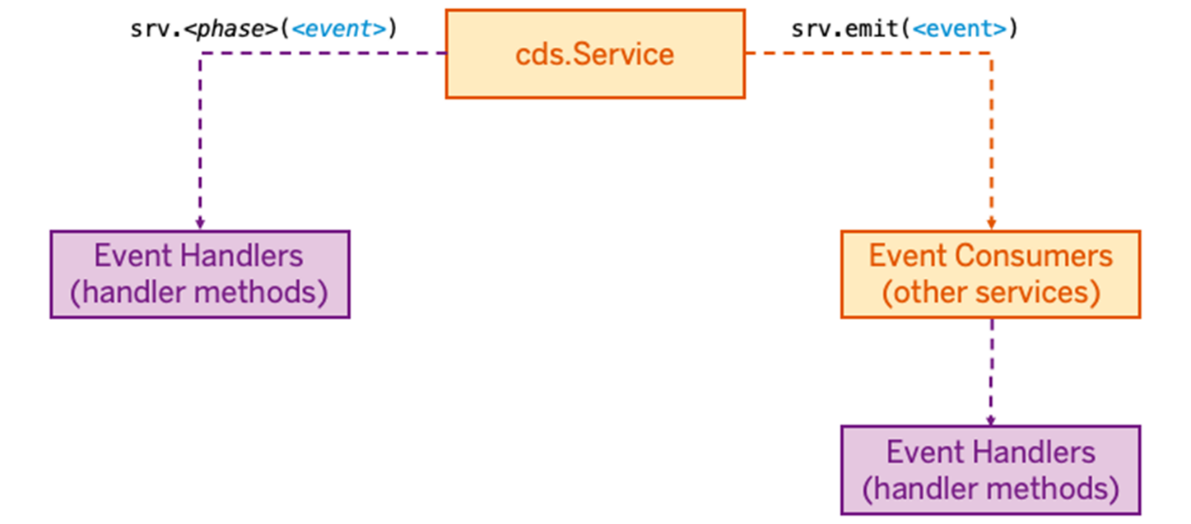
Event Handlers
In CAP everything that happens at runtime is an event that is sent to a service. They are a powerful means to extend CAP. An event handler is simply a method, that is executed when something happens in the application.
If you need a specific service to react to a specific event, you register an event handler using srv.<phase>(<event>), where
srv is the instance of the service that you are extending,
<phase> is one of on, before, or after
<event> is any kind of named event as a string (e.g. 'READ').
Once a service has an event handler for a specific event, it becomes a consumer for that event. Using srv.emit(<event>), a service can send arbitrary events. These events then get consumed by other services that have event handlers registered for the respective event.

Slide 13
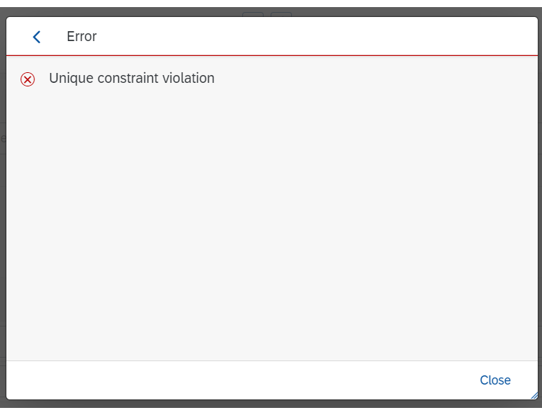
Error Handling
When an error occurs, it should be possible to know the root cause. The CAP SDK for Node.js also throws exceptions, for example when a CRUD operation violates the foreign key constraints. In this case, the framework throws the exception UNIQUE_CONSTRAINT_VIOLATION. The problem in this case is that the end user will only see a more or less cryptic error message:
It is therefore useful to provide a meaningful error message.
Error Types
Proper error handling is crucial for today's business applications. Before going into more detail, it is necessary to distinguish between two types of errors:
Programmer errors.
These occur as a result of programming errors (e.g. 'foo' cannot be read by undefined). They must be corrected.
Operational errors
These occur during runtime (e.g. when sending a request to a faulty remote system). They must be corrected.

Slide 14
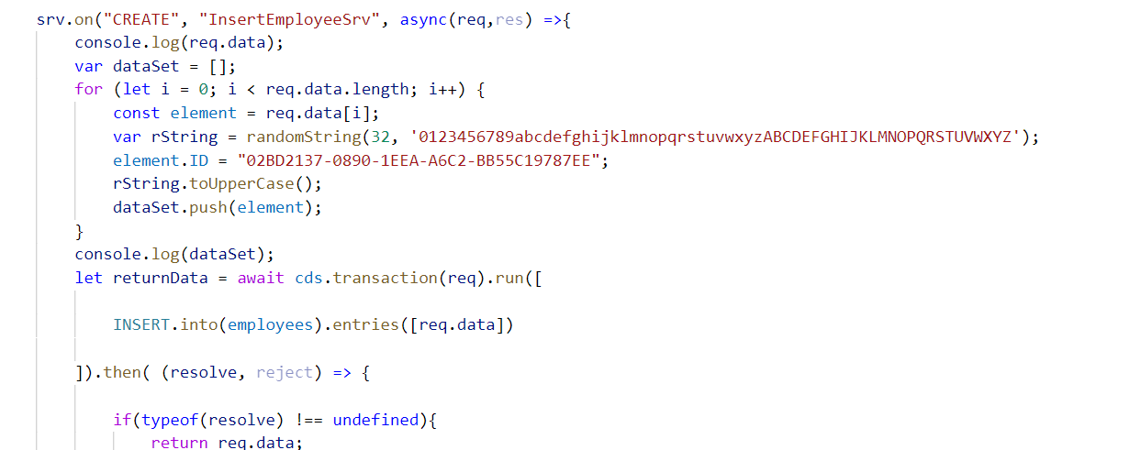
Hands-on: Event Handlers
To understand the concept of event handlers we will create a new service named mysimpleservice.cds and mysimpleservice.js to write the event handler code. In this exercise we will expose the employee set in different entity sets to perform different tasks.
Create two new files mysimpleservice.cds and mysimpleservice.js
Copy the code form below links and past it into the newly created files.
Run the project using cds run or cds watch command.
Test the operations from postman tool.
Exercise code/resource:-
mysimpleservice.cds
mysimpleservice.js
CatalogService.js
Test.http

Slide 15
CDS Query Language (CQL)
The CDS Query Language (QL) is an extension to SQL used to consume CDS data. The QL includes enhancements such as defining views within the CDS data model. It also introduces the use of associations defined by the DDL. Instance-based authorization to CDS entities are defined using the Data Control Language (DCL).
CQL allows to put projections, that means, the SELECT clause, behind the FROM clause enclosed in curly braces. For example, the following are equivalent:
SELECT nameFirst, email from employees
We can also use the CQL in NodeJS to perform custom database operations at the runtime of the application. The above CQL statement can be written in NodeJS as:
//CDS Query Language - SELECT * FROM dbtab
SELECT.from(employees).columns(nameFirst, email)
The filter statements in NodeJS to get the filter data is written the CDS Query Notation.
CQN is a canonical plain object representation of CDS queries. Such query objects can be obtained by parsing CQL, by using the query builder APIs, or by simply constructing respective objects directly in your code.
Example:
{SELECT:{from:[{ref:['employees']}]}}

Slide 16
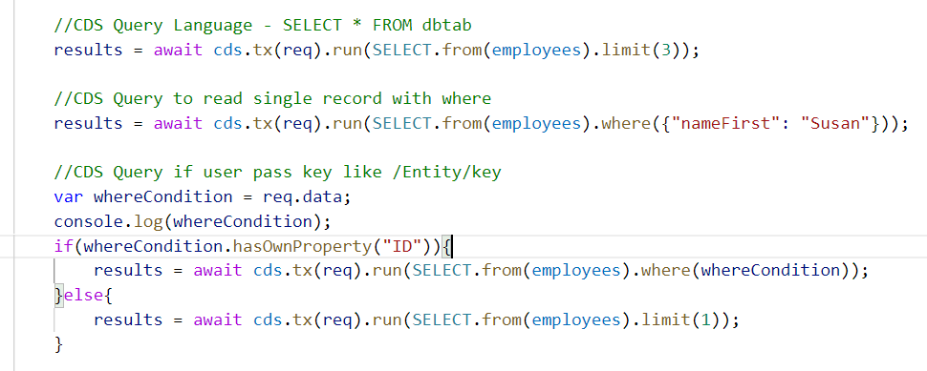
Hands-no: CDS Query Language
In this exercise we will see how to use the CDS Query Language to perform database operations at run time.
Exercise Code/resources:
myfirstservice.cds
Test.http

Slide 17
Custom Actions and Function in CAPM
Actions and Functions allow us to modify or perform additional operations of the data which is beyond simple CURD functionality.
Actions
Actions are operations exposed by an OData service that MAY have side effects when invoked. Actions MAY return data but MUST NOT be further composed with additional path segments.
Functions
Functions are operations exposed by an OData service that MUST return data and MUST have no observable side effects.
Simply put, Actions can be used to modify data, while Functions are used to get specific (set of) data.
Within service definitions, you can additionally specify actions and functions. Use a comma-separated list of named and typed inbound parameters and an optional response type, which can be either a:
entity POs as projection on transaction.purchaseorder actions{
function largestOrder() returns array of POs;
action boost();
}

Slide 18
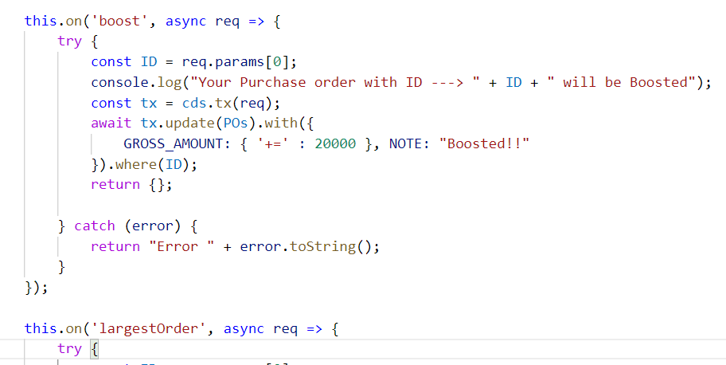
Hands-on: Actions and Functions
Create a custom boost action and a custom function to get the largest order in the Catalog Service and test it using the Test.http.
Exercise Code/Resource:
CatalogService.cds
CatalogService.js
Test.http

Slide 19
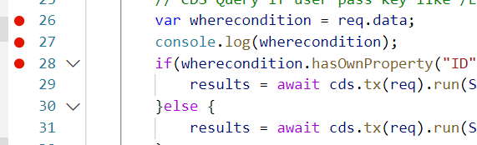
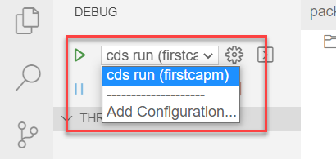
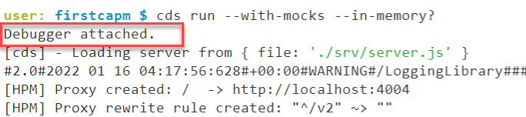
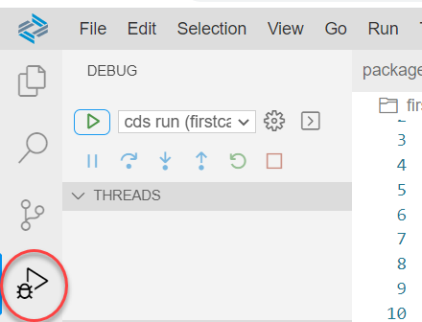
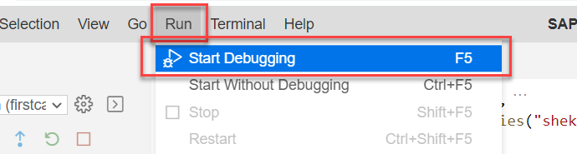
Debugging Node JS in BAS
Debugging is a concept to identify and remove errors (‘bugs’) from software applications.
Using console.log to debug the code generally dives into an infinite loop of “stopping the app and adding a console.log, and start the app again” operations. Besides slowing down the development of the app, it also makes the writing dirty and creates unnecessary code.
So SAP BAS and VS Code provides a better way of debugging the Node.js.
Steps to attach debugger in NodeJS
First Attach the debuggers to the module which we want to debug.
Go to the debug terminal by clicking on the debug icon and select the module you want to debug.
Start the debugger using the start icon on debug window.
You can also start debugging form the Run and Start debugging.
Once starting you will see a Debugger attached in the Terminal.

Slide 20
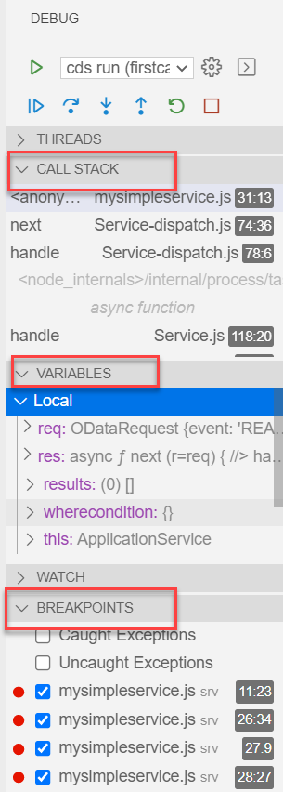
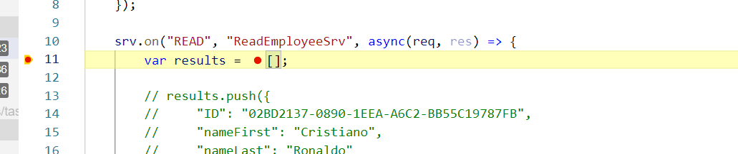
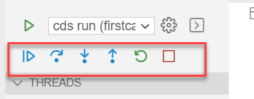
Steps to use debugger
Once the debugger is attached to our application. We should know how to use the debugger window to find the errors and debug the code.
So, when the debugger hit an operation in the BAS it will look like this. And the debug window will show us the variables and the breakpoint which are there in our code.
We can run the debugger step by step as we wanted using the panel given on the debug window.
We can also use shortcuts to move the debugger.
F5 – To move the debugger to the completely until the next break point
F10 – Move debugger to the next line of code.

Slide 21
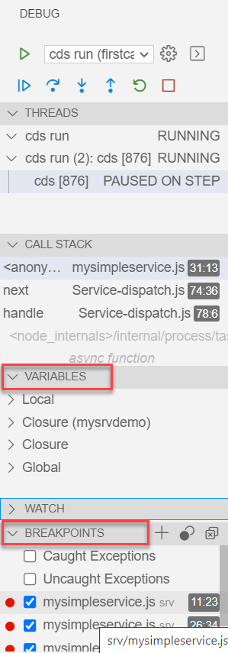
Hands-on: Debugging
Try to debug the NodeJS code in the Business Application Studio. Have a look at the debugging window and perform the operations on the debugging console.

Slide 22


What is SAP UI5?
SAPUI5 (SAP user interface for HTML5) is a collection of libraries that you can use to build desktop and mobile applications that run in a browser. With the SAPUI5 JavaScript toolkit, you can create web applications using HTML5 web development standards.
SAP UI5 is a framework which is used to develop Responsive web applications to run on any platform, any browser and any OS.
Responsive
App which can adapt itself according the different devices
Framework
It’s a collection of Libraries.
Library
Collection of classes.
Classes
Collection of methods, Attributes, Events

Slide 23
Responsive Web Design
Responsive web design (RWD) is a web development approach that creates dynamic changes to the appearance of a web application, depending on the screen size and orientation of the device being used to view it.
Responsive Web Design is about using HTML and CSS to automatically resize, hide, shrink, or enlarge, a website, to make it look good on all devices (desktops, tablets, and phones).
Now a days, all the frameworks are designed to adept the UI according to the screen size of the device.

Slide 24
Client Server Architecture
The task of the client/server technology components is to provide a reusable runtime environment for other components that use the client server technology as the basis on which to process requests. The focus is on optimizing operating system resources (CPU, memory, etc.), in terms of performance, scalability, and robustness.
In addition to the components in the SAP kernel there are programs that regulate data traffic in the network, such as the SAP router and the SAP Web Dispatcher, as well as smaller monitoring and test programs.
SAP
Server
Computer on cloud
IP Address
Fiori
Request – header + body(optional)
Response – header + body(html,xml, json,excel, pdf, word,….)
Request Types
GET – Read Data
POST – Create new Data
PUT – Update
DELETE – Remove Data

Slide 25
Structure of UI5 Framework
The UI5 framework is built on top of open standards like HTML5, CSS, JS, and jQuery. We use MVC architecture to create applications using SAPUI5.
BAS or
VSCode
App
SAP UI5 Design Time Component
SAPUI5 Runtime Component
HTML+CSS+JS
sap.m
sap.ui.comp
sap.ui.table
sap.ui.layout
Renderer
sap.ui.core
sap.ui.unified
sap.ui.core.mvc
HTML5
CSS
JS
jQuery

Slide 26
Introduction to MVC Architecture
MVC stands for Model, View, Controller.
Model:- The model component is a freely composed class that will keep the application data and do manipulations on it. All database accesses are done within the model.
View:- The View is responsible for defining the user interface to users. When a user sends a requests from his device, the view is responsible for data view as per the request submitted.
Controller:- The Controller is used to control the data and view events as per user interaction by updating the view and model.
<event>
Processing
Controller
eventHandler
<notifies>
<done>
<modifies>
I/O
View
Data binding
Data
Models
MVC Architecture

Slide 27

End of Day 7

Slide 28

Questions

Slide 29

Anubhav Oberoy

Slide 30


We’re committed to empower you to be
Most Desirable Resource
through powerful training solutions.
We build the workforce of the future.
270+
Corporate Clients
30,000+
Learners Trained
27000+
Learners Placed
FREE WEBINARS
Sign up for free webinars with industry experts every fortnight!
Enroll Now!
Contact us today!
https://anubhavtrainings.com/

Slide 31




More from AnubhavTrainings.com

Slide 32
Title
Content

